Slide 1
The multi-talented razor
In support of lauded appearance in MVC3 as “View Engine”, Razor makes appearance in DotNetNuke playing the part of “Scripting Language”

Slide 2
Introducing…Razor
View Engine? Scripting language? Templating language?
Gu Says: “HTML generation … code-focused templating”
Clean syntax, fewer characters
Code is “first class”

Slide 3
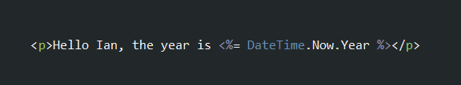
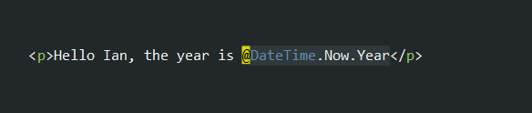
syntax
ASPX
Razor

Slide 4
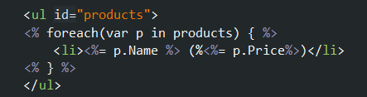
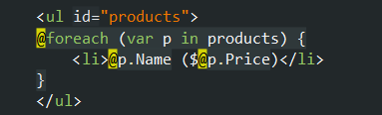
Syntax
ASPX
Razor

Slide 5
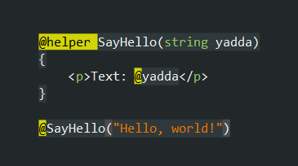
Helpers

Slide 6
ASP.nET MVC 3
Ships with choice of ASPX or Razor as view engine
Displaying and working with data (your model)
Cool: Automatic HTML Encoding
ASP.NET MVC 3 is an Open Source MVC Framework on .NET
Version 3 Released January 2011

Slide 7
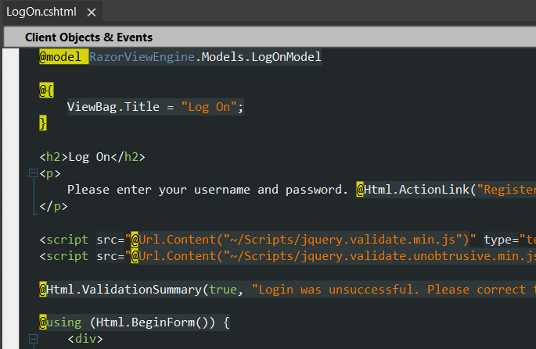
ASP.NET MVc 3 DEMO

Slide 8
WEB MATRIX
Think “PHP Story”
“Entry level” application creation
“Web Pages” .cshtml
In this world…
Razor scripting allows dynamic features

Slide 9
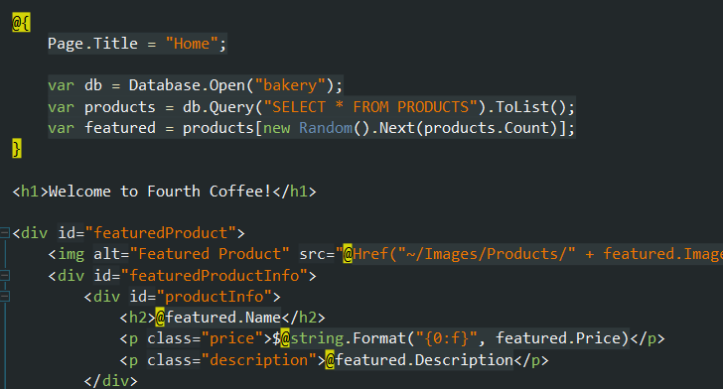
Web matrix DEMO

Slide 10
DotNetNuke
Enable light weight but powerful development
Not the new approach, but a new approach
Razor host module
Similar to web matrix style development
Less the nice IDE
Add DNN Context (API)

Slide 11
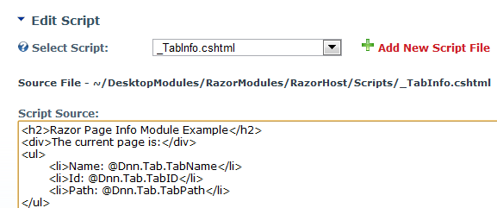
Razor host module

Slide 12

A razor module
MyModule.ascx
Inherits from RazorModuleBase
_MyModule.cshtml
Contains html/js/razor
Host -> Module Definitions
Create new module -> From Control

Slide 13
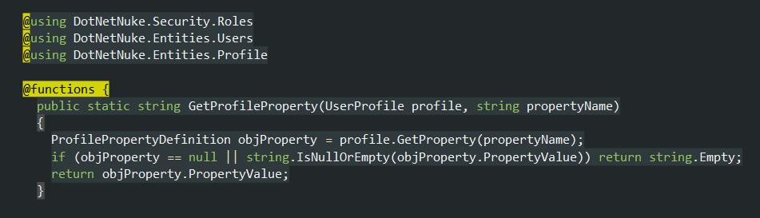
User map demo

